Slide 1
DFD – WIREFRAME (Cycling needs Inventory System)
Presented by: Leomhar Manuel

Slide 2
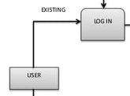
User Account - lOGIN
Physical Dfd
DATA | DATA TYPE | USER INTERFACE | DATA STRUCTURE AND ALGORITHM
EMAIL | STRING | LINE EDIT
PASSWORD | STRING/INT | LINE EDIT

Slide 3
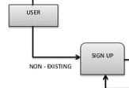
User Account - SIGNUP
Physical Dfd
DATA | DATA TYPE | USER INTERFACE | DATA STRUCTURE AND ALGORITHM
NAME | STRING | LINE EDIT
AGE | INTEGER | LINE EDIT
EMAIL | STRING/INT | LINE EDIT
CONTACT NO. | INTEGER | LINE EDIT
PASSWORD | STRING/INT | LINE EDIT
CONFIRM PASSWORD | STRING/INT | LINE EDIT

Slide 4

User Account - ORDER
Physical Dfd
DATA | DATA TYPE | USER INTERFACE | DATA STRUCTURE AND ALGORITHM
NAME | STRING | LINE EDIT
ORDER | STRING | LINE EDIT
TIME/DATE | INTEGER | QDATE TIME EDIT

Slide 5
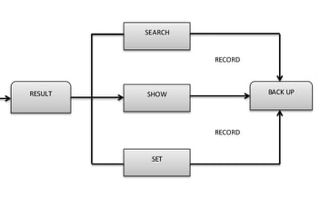
USER ACCOUNT – SEARCH, SHOW, SET
Physical Dfd
DATA | DATA TYPE | USER INTERFACE | DATA STRUCTURE AND ALGORITHM
PRODUCT | STRING | LINE EDIT | SEARCH
DISPLAY/SHOW |  | BUTTON
SET |  | BUTTON | SORT

